Slide 1
Minimum Spanning Trees
By:
Avinash Kumar Kumar
(Assistant Professor, CSE Department)

Slide 2
Problem: Laying Telephone Wire
Central office

Slide 3
Wiring: Naïve Approach
Central office
Expensive!

Slide 4
Wiring: Better Approach
Central office
Minimize the total length of wire connecting the customers

Slide 5
Minimum Spanning Tree (MST)
A minimum spanning tree is a subgraph of an undirected weighted graph G, such that
it is a tree (i.e., it is acyclic)
it covers all the vertices V
contains |V| - 1 edges
the total cost associated with tree edges is the minimum among all possible spanning trees
not necessarily unique

Slide 6
Applications of MST
Any time you want to visit all vertices in a graph at minimum cost (e.g., wire routing on printed circuit boards, sewer pipe layout, road planning…)
Internet content distribution
$$$, also a hot research topic
Idea: publisher produces web pages, content distribution network replicates web pages to many locations so consumers can access at higher speed
MST may not be good enough!
content distribution on minimum cost tree may take a long time!

Slide 7
How Can We Generate a MST?
9
b
9
b
a
2
6
a
2
6
d
d
4
5
4
5
5
4
5
4
5
e
5
e
c
c

Slide 8
Methods for Creating MST:
Kruskal’s Algorithm
Prism's Algorithm

Slide 9
1. Kruskal’s algorithm:
Initialization
a. Create a set for each vertex v ∈ V
b. Initialize the set of “safe edges” A comprising the MST to the empty set
c. Sort edges by increasing weight
For each edge (u,v) ∈ E in increasing order while more than one set remains:
If u and v, belong to different sets U and V
a. add edge (u,v) to the safe edge set
A = A ∪ {(u,v)}
b. merge the sets U and V
9
b
a
2
6
d
4
5
F = {a}, {b}, {c}, {d}, {e}
A = ∅
E = {(a,d), (c,d), (d,e), (a,c),
(b,e), (c,e), (b,d), (a,b)}
5
4
5
e
c

Slide 10
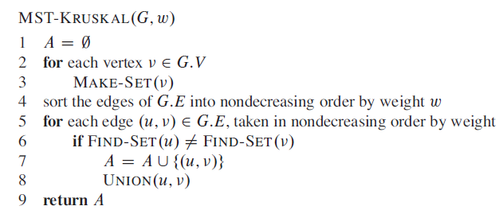
Kruskal’s algorithm (contd..)
Running time bounded by sorting (or findMin)
O(|E|log|E|), or equivalently, O(|E|log|V|)

Slide 11
Kruskal’s algorithm
9
b
a
2
6
E = {(a,d), (c,d), (d,e), (a,c),
(b,e), (c,e), (b,d), (a,b)}
d
4
5
5
4
5
e
c
Forest
{a}, {b}, {c}, {d}, {e}
{a,d}, {b}, {c}, {e}
{a,d,c}, {b}, {e}
{a,d,c,e}, {b}
{a,d,c,e,b}
A
∅
{(a,d)}
{(a,d), (c,d)}
{(a,d), (c,d), (d,e)}
{(a,d), (c,d), (d,e), (b,e)}

Slide 12
Kruskal’s Algorithm Invariant
After each iteration, every tree in the forest is a MST of the vertices it connects
Algorithm terminates when all vertices are connected into one tree

Slide 13
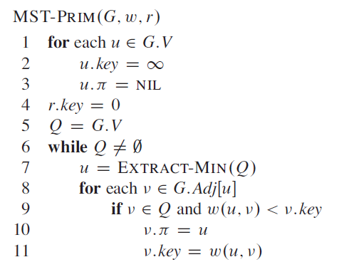
1. Prim’s Algorithm
9
b
a
2
6
d
4
5
5
4
5
e
c
e
a
b
c
d
Vertex Parent
e -
0
∞
∞
∞
∞

Slide 14
Prim’s algorithm
Vertex Parent
e -
b -
c -
d -
e
d
b
c
a
0
∞
∞
∞
∞
9
b
a
2
6
d
4
5
Vertex Parent
e -
b e
c e
d e
5
4
d
b
c
a
5
e
c
4
5
5
∞
The MST initially consists of the vertex e, and we update
the distances and parent for its adjacent vertices

Slide 15
Prim’s algorithm
Vertex Parent
e -
b e
c e
d e
d
b
c
a
4
5
5
∞
9
b
a
2
6
d
4
5
5
4
Vertex Parent
e -
b e
c d
d e
a d
5
e
c
a
c
b
2
4
5

Slide 16
Prim’s algorithm
Vertex Parent
e -
b e
c d
d e
a d
a
c
b
2
4
5
9
b
a
2
6
d
4
5
5
4
5
e
c
Vertex Parent
e -
b e
c d
d e
a d
c
b
4
5

Slide 17
Prim’s algorithm
Vertex Parent
e -
b e
c d
d e
a d
c
b
9
b
4
5
a
2
6
d
4
5
5
4
5
e
Vertex Parent
e -
b e
c d
d e
a d
c
b
5

Slide 18
Prim’s algorithm
Vertex Parent
e -
b e
c d
d e
a d
b
5
9
b
a
2
6
d
4
5
5
4
5
e
c
Vertex Parent
e -
b e
c d
d e
a d
The final minimum spanning tree

Slide 19
Running time of Prim’s algorithm (without heaps)
Initialization of priority queue (array): O(|V|)
Update loop: |V| calls
Choosing vertex with minimum cost edge: O(|V|)
Updating distance values of unconnected vertices: each edge is considered only once during entire execution, for a total of O(|E|) updates
Overall cost without heaps:
When heaps are used, apply same analysis as for Dijkstra’s algorithm (p.469) (good exercise)
O(|E| + |V| ²)

Slide 20
Thank You..!

